Slide 1
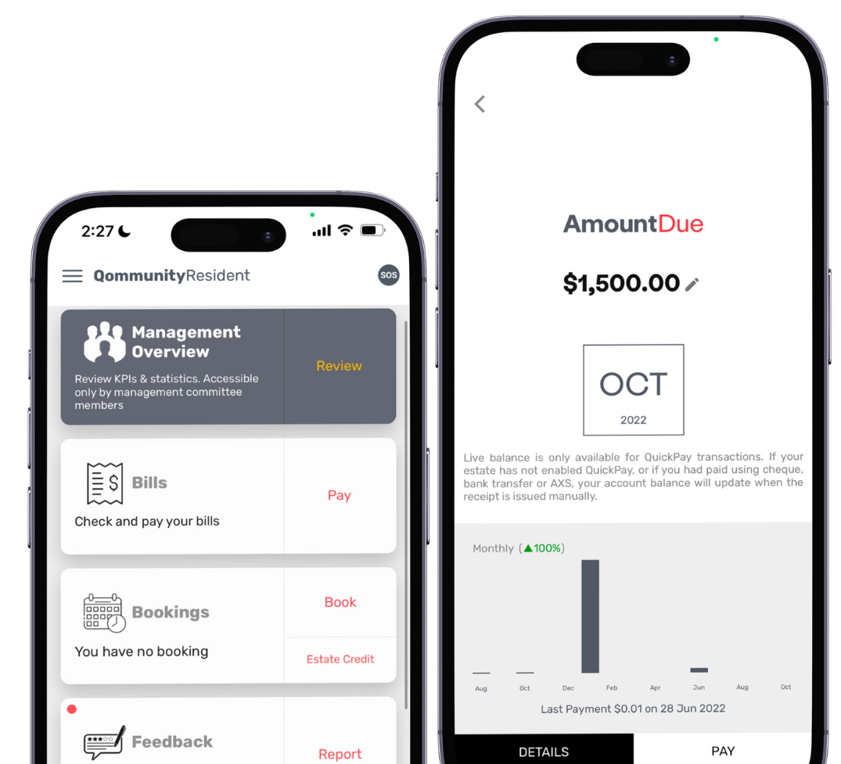
The MCST Plan No. ____
C/o [Address here]
Launching on [Date]
Qommunity Resident App
View & Pay Bills using QuickPayTM
(no fees to payer)
Book Facilities
Feedback, Announcement, e-applications
Visitor management & Door Access (where available)
Others
App Account Activation
- Look out for Welcome Letter or QR code in next bill
Learn More About QuickPay
www.qornerstone.com/quickpay
Download Qommunity Resident
- Search your App Store
Qommunity Privacy Policy & Terms of Use
www.qornerstone.com/qommunity

