Slide 1
WELCOME LETTER - PURPOSE
Issue Welcome Letter to SPs to enable them to activate their Resident Mobile App
NOTE: SPs will have to download the Resident Mobile App, use the QR Code Scanner in the Qommunity Resident App to scan the QR Code on the Welcome Letter in order to activate their account

Slide 2
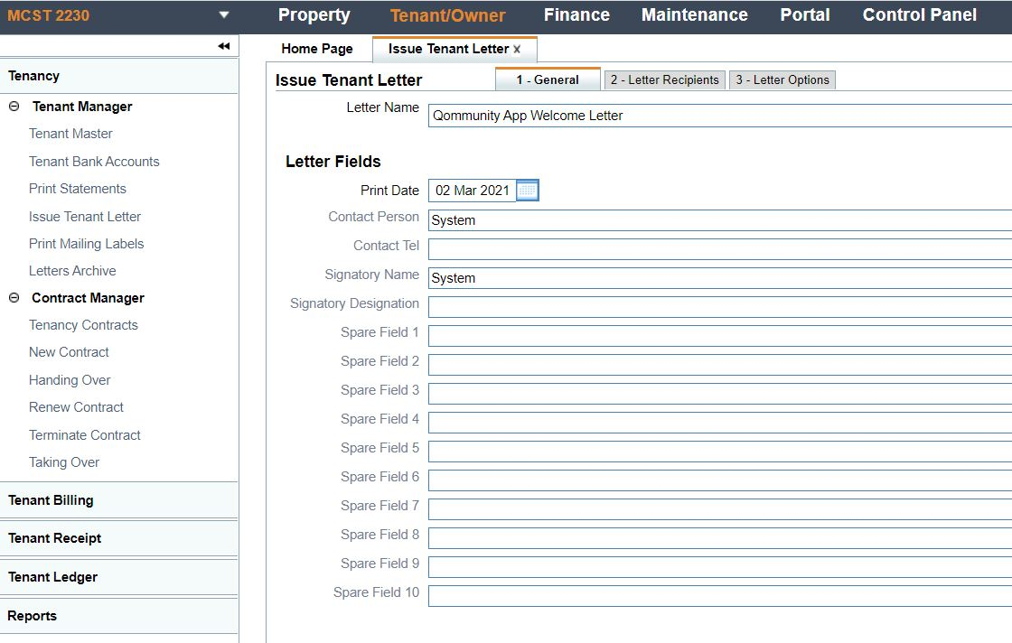
WELCOME LETTER – STEP BY STEP
1
Tenant Manager
Issue Tenant Letter
Select Qommunity App Welcome Letter
3
2

Slide 3
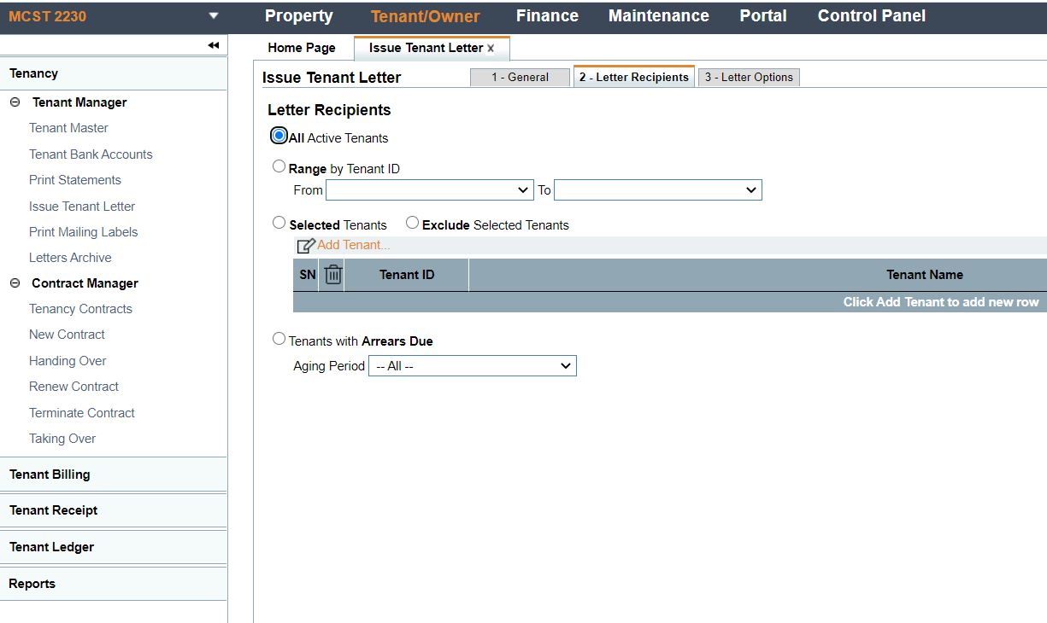
WELCOME LETTER – STEP BY STEP
3. Letter Receipts Tab
4. Select ‘All Active Tenants’ (SPs)
4
5
You can use “All active Tenants” for everyone you want to send to.

Slide 4
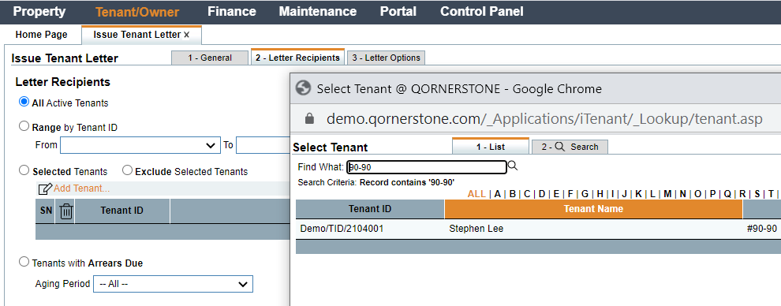
WELCOME LETTER – STEP BY STEP
Select by Tenant
Use “Select Tenant” when you are only sending to a selected list of SPs

Slide 5
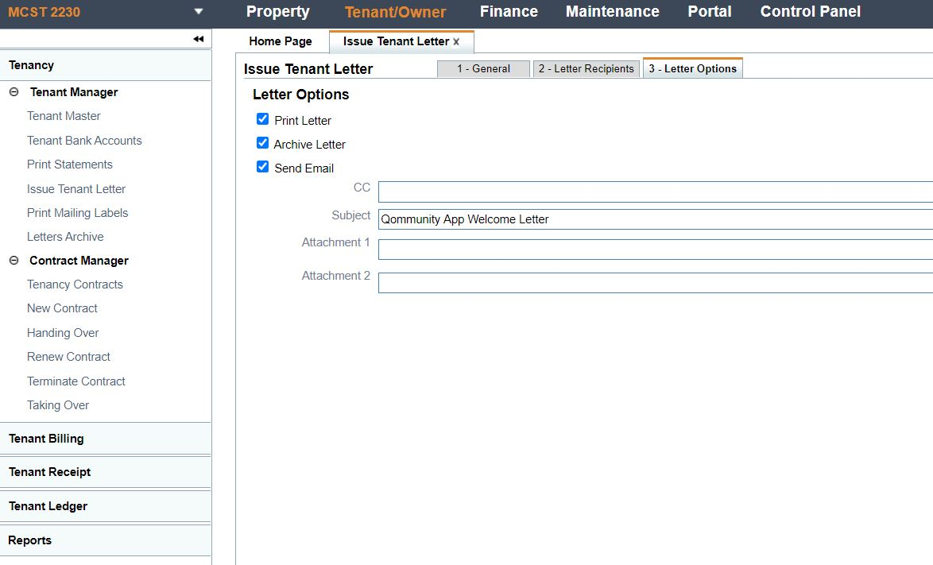
WELCOME LETTER – STEP BY STEP
5. Letter Options Tab
6. Select Relevant Options
Unclick “Send Email” if you are only printing out the letter. To use send email, you must have the SP’s emails.

Slide 6
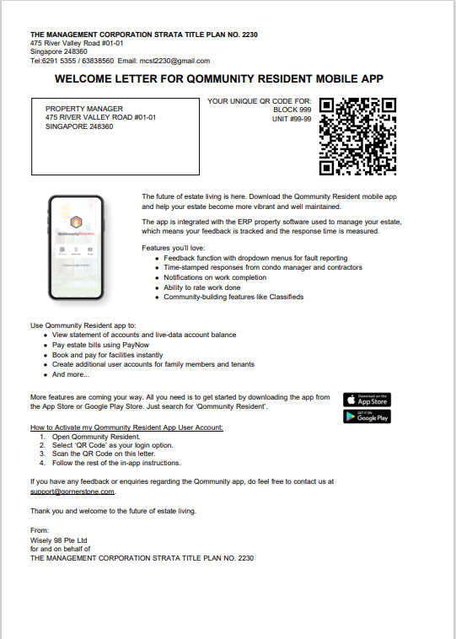
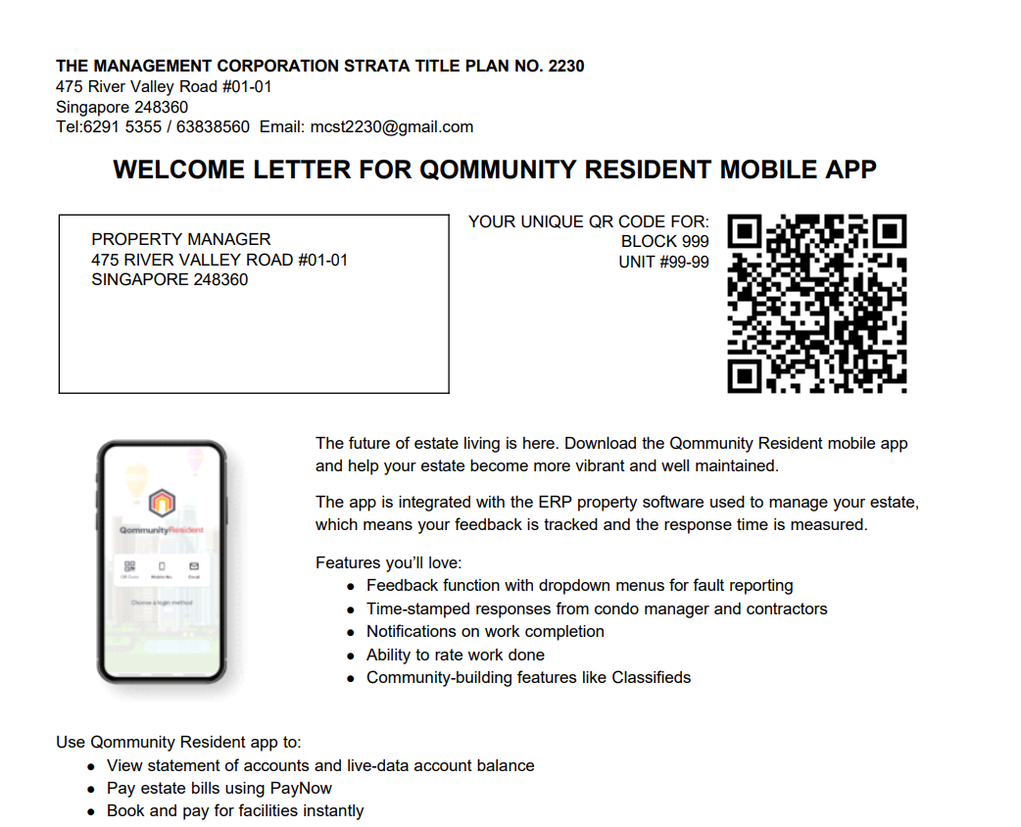
WELCOME LETTER

