Slide 1
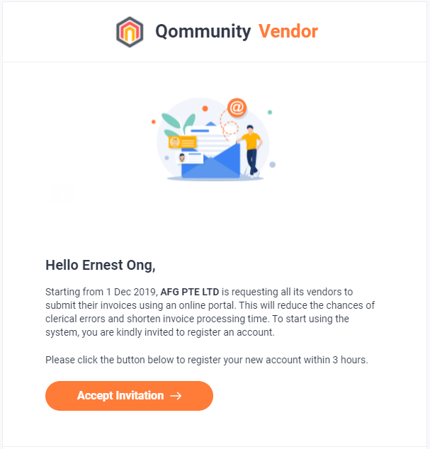
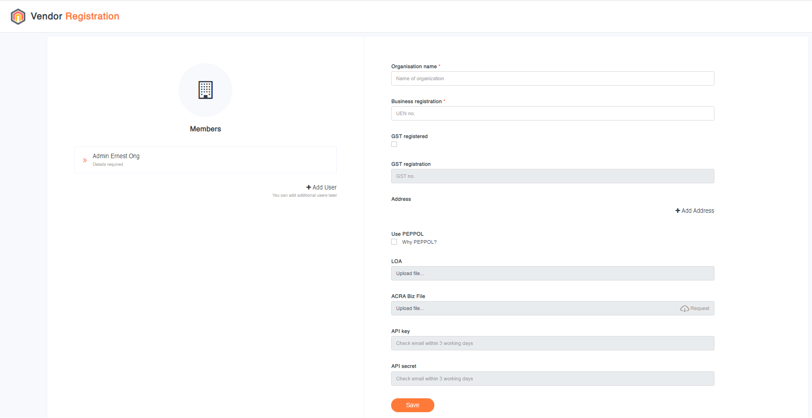
HOW TO REGISTER AS Q. VENDOR SUPPLIER?
Q.Vendor supplier registration is by invitation only whereby the Supplier must receive an invitation email to register as Q.Vendor Supplier under at least 1 Invoicee i.e., Customer (Q.Vendor Host).
Vendor/supplier clicks on [Accept Invitation] to open the online registration form to populate the required information before clicking [Save].
The Supplier can create additional user accounts and to specify the PEPPOL details, if required.

Slide 2
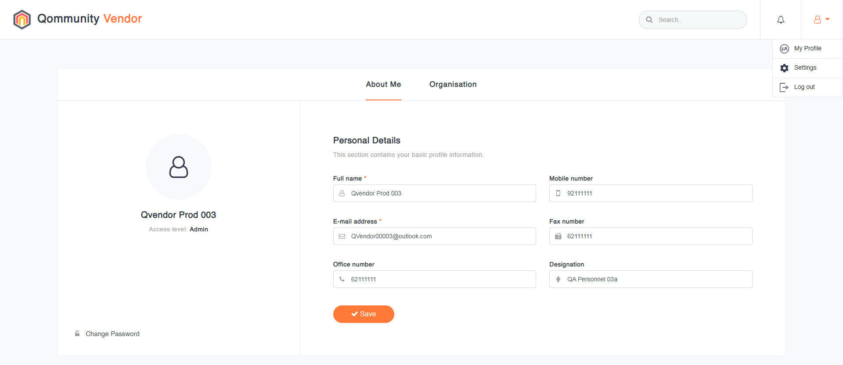
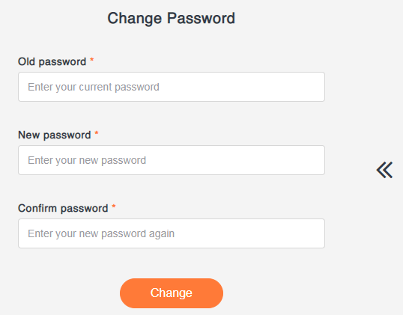
HOW TO UPDATE SUPPLIER INFORMATION?
Supplier is empowered to update your most up-to-date information via the [My Profile] Page. Upon clicking [Save], the updated Supplier information would automatically sync with the Q.Finance Supplier records.
Supplier can change their Q.Vendor password frequently as a form of good security practice.

Slide 3
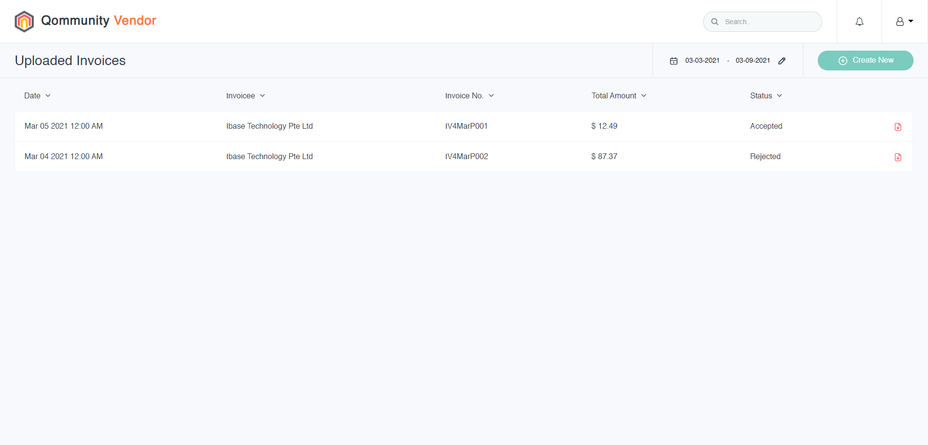
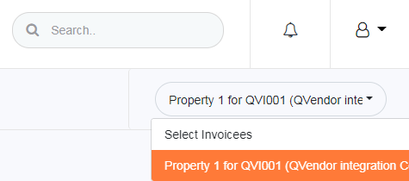
HOW TO SUBMIT E-INVOICE?
Registered Supplier can log into the Q.Vendor with a valid ID & Password.
To submit an Invoice, Supplier clicks on [Create New], followed by selecting the Invoicee from a drop-down menu. An Invoicee is the Customer that Supplier intends to bill. Note: Q.Vendor is an Enterprise Grade system designed to support Multi-Suppliers and Multi-Customer environment.

Slide 4
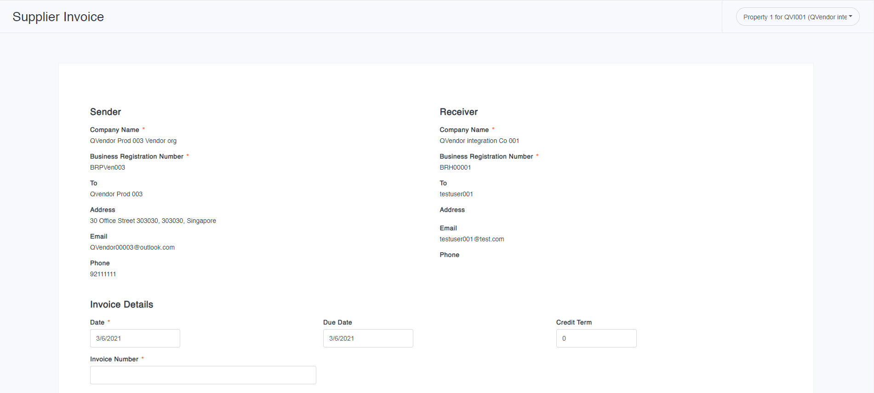
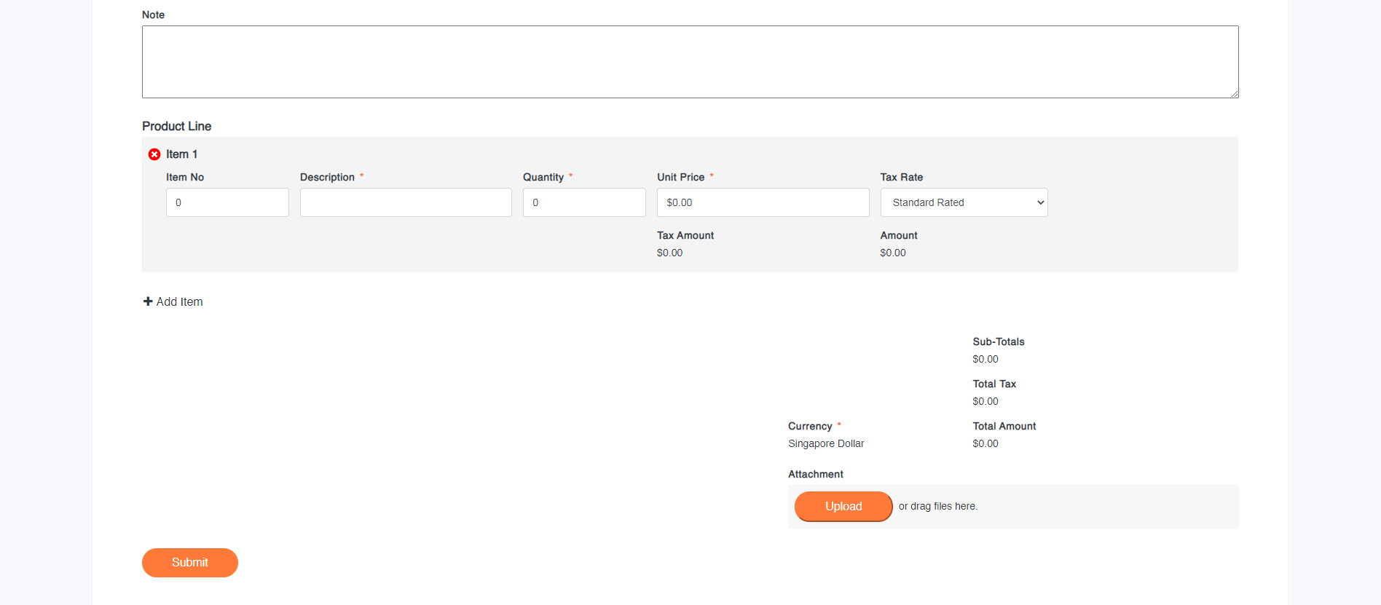
HOW TO SUBMIT E-INVOICE?
After selecting the Invoicee, Supplier to furnish the Invoice details onto the electronic forms and attach supporting documents where required.

Slide 5
HOW TO VIEW E-INVOICE STATUS?
On the main Q.Vendor page, the Supplier can view a list of previously submitted Invoices and its details such as Date, Invoicee, Invoice Number, Total Amount and Status. There are 3 Status, namely
Processing = Invoice is not verified yet.
Accepted = Invoice is verified and accepted for payment.
Rejected = Invoice verified and not accepted for payment; re-submission may be required.
Tips: Use the Date Range function if the listing is long.

Slide 6
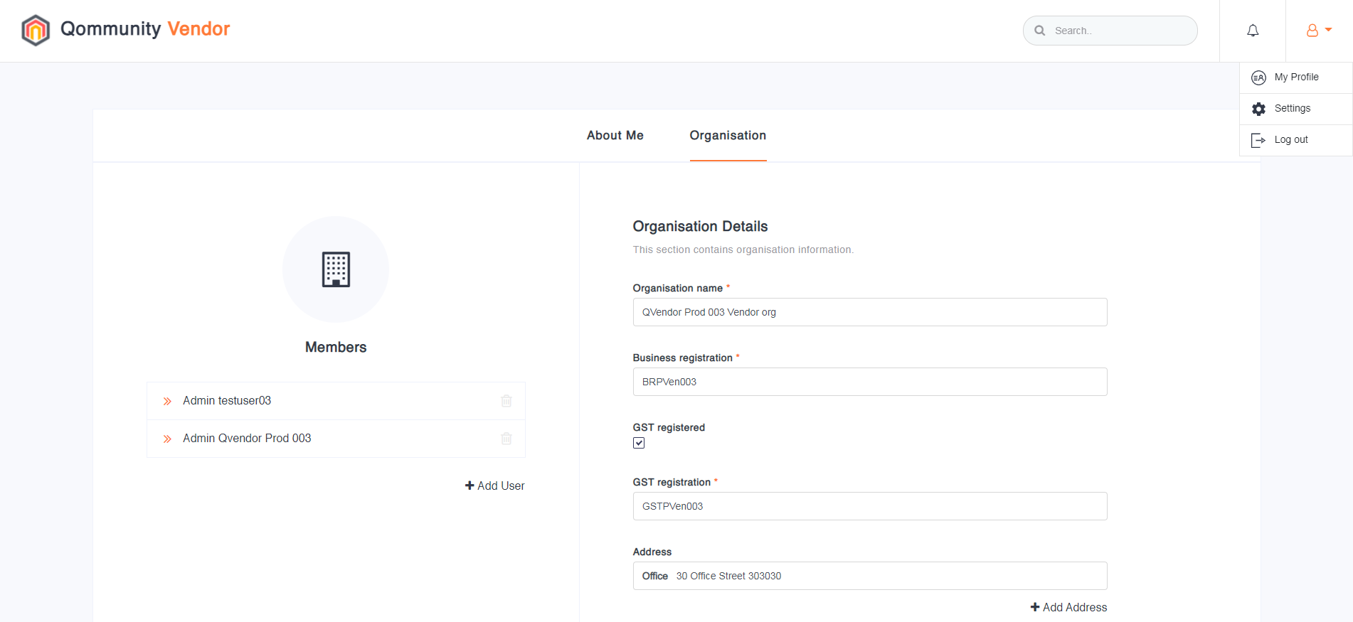
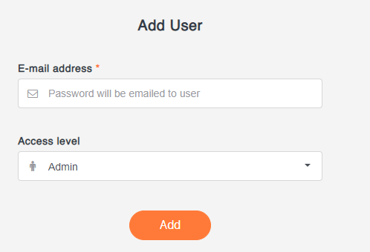
HOW TO ADD NEW SUPPLIER USER ACCOUNT?
The Supplier may add new members to the Q.Vendor. On clicking [My Profile] followed by [Organization], the Organization details and member account would be shown on the page.
To add New Supplier User account, click on [Add User] to input the Email Address and assign an Access Level before clicking [Add].
Note: There are 2 Access Levels, namely Admin and Member Account. Admin Account is empowered to make changes to the organization details, whereas Member Account can only submit E-Invoices.
1

