Slide 1
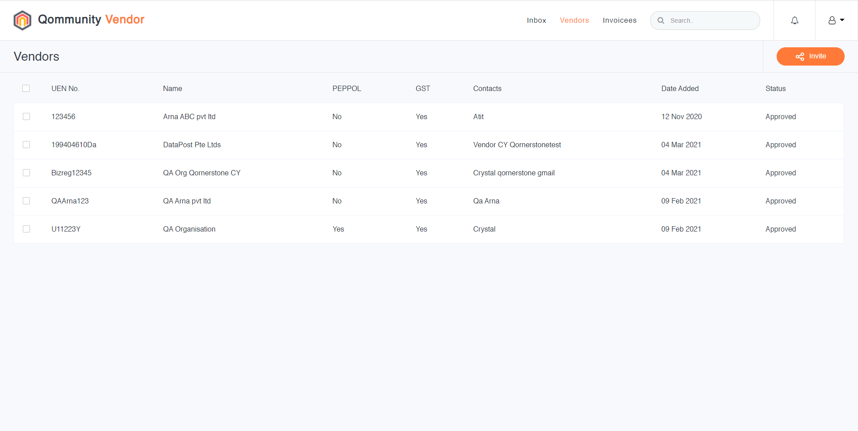
INVITE SUPPLIER TO SIGN UP Q.VENDOR
Log into Q.Vendor.
Under the Vendors Module, the registered Vendor’s names and Status are shown in the listing.
1

Slide 2
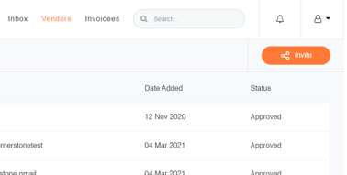
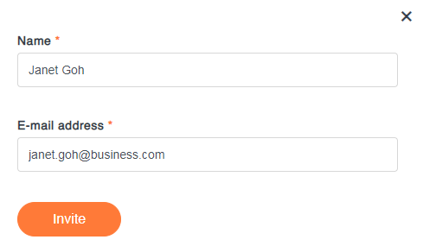
To invite a Vendor to join Q.Vendor, click on the [Invite] to pop-up a page.
After specifying the Name & E-mail address of the Vendor, click on [Invite] to send the email invitation.

Slide 3
Once a Suppliers had self-registered successfully, you can click on the Vendor listing line item to review the detailed Supplier info. To remove a particular Supplier, simply click on [Delete].
Note: The Supplier information would automatically sync with the Q.Finance Supplier Module.
Deleted Supplier would auto Inactivate the Supplier record in the Q.Finance.
3

Slide 4
C3. HOW TO VERIFY E-INVOICES @ Q.VENDOR?
Upon logging into Q.Vendor, you can see a list of Received Invoices. The listing categories are Date, Invoicee, Invoice No., Total Amount and Status.
Note: You can setup multiple Invoicee accounts, e.g., each Invoicee Account can be a MCST. And the status are Processing, Accepted or Rejected.
The User clicks on each invoice line item to view the invoice details.

Slide 5
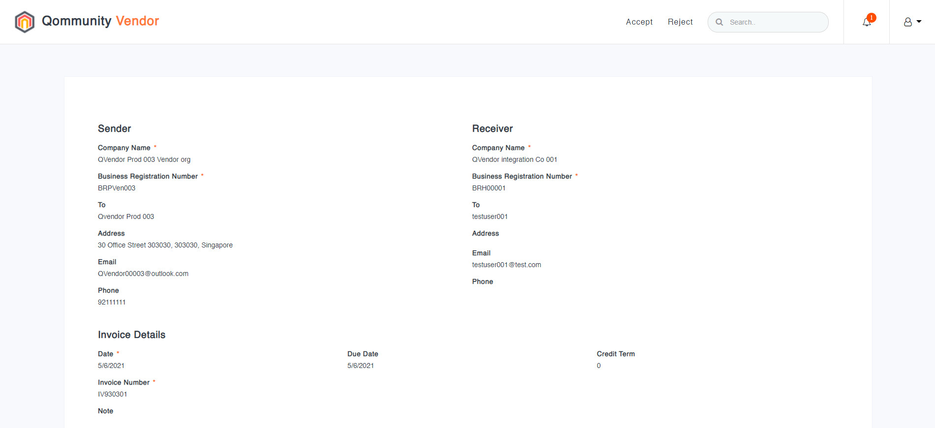
Click on the desired Invoice line item to view the invoice details.
After verifying the invoice details and the attached documents, click on [Accept] or [Reject], where the status is updated accordingly.

Slide 6
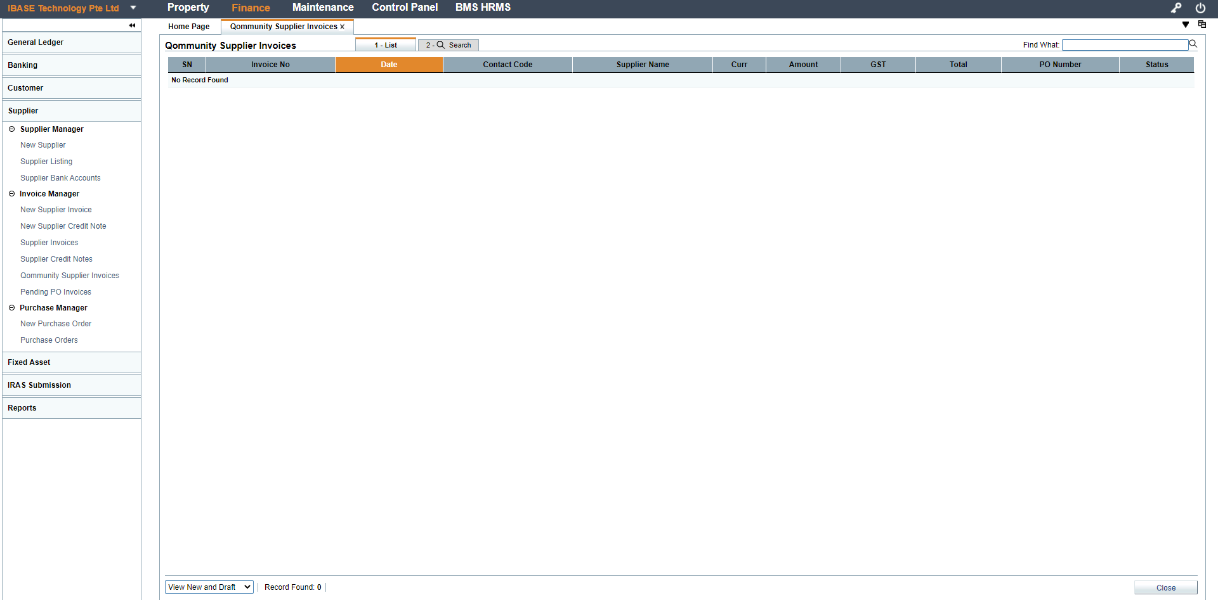
VERIFY E-INVOICES @ Q.FINANCE
Once the E-Invoice is verified and accepted at Q.Vendor, the E-invoice would flow to Q.Finance for the finance personnel verification. At Q.Finance, the accounts user clicks on [Qommunity Supplier Invoice] to view the list of E-Invoice that needs verification.

Slide 7
The account user clicks on the desired Invoice line item to view the invoice details.
After verifying the invoice details and the attached documents, the user defines the Account Code and click on [Accept] or [Reject], where the status is updated accordingly.
For accepted invoice, a Supplier Invoice shall be automatically created in Q.Finance for payment processing.

